Slide 1

DEVELOPING THE CONCEPTUAL MODEL
Presented By :- SNEHAL TAWAR

Slide 2
Contents:
Introduction
A Framework for Conceptual Modelling
Methods of Model Simplification
Conclusion
References

Slide 3

Introduction
How to develop a conceptual model, this question is answered from two perspectives. First, a framework for developing a conceptual model is described. Secondly, some methods of model simplification are discussed. This first perspective starts from the standpoint that the modeller has a blank sheet of paper. The second perspective assumes that the modeller has a model design and is looking for ways to improve it.

Slide 4
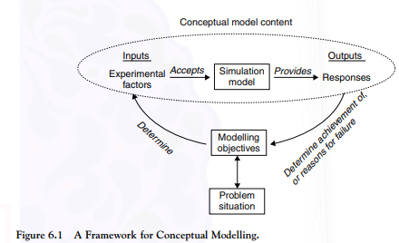
A Framework for Conceptual Modelling
The purpose of this framework is to provide a modeller with an understanding of how to develop a conceptual model. The framework consists of four key elements:
Develop an understanding of the problem situation
Determine the modelling objectives
Design the conceptual model: inputs and outputs
Design the conceptual model: the model content

Slide 5
Methods of Model Simplification
Model simplification involves reducing the scope and level of detail in a conceptual model either by:
removing components and interconnections that have little effect on model accuracy or by:
representing more simply components and interconnections while maintaining a satisfactory level of model accuracy
Aggregation of model components
Aggregation of model components provides a means for reducing the level of detail. Two specific approaches are described here: black-box modelling and grouping entities
Excluding components and details
Some details may be excluded from a model because they, too, are deemed to have little impact on model accuracy.
Replacing components with random variables
Rather than model a component or group of components in detail it may be possible to represent them as a set of random variables, sampled from some distributions
Excluding infrequent events
Reducing the rule set
A model can be simplified by reducing the rule set, while maintaining a sufficient level of accuracy
Splitting models
Rather than build one large model, it can be beneficial to split the model into two or more parts. A simple way of achieving this is to split the models such that the output of one sub-model (model A) is the input to another (model B)
What is a good simplification?
A good simplification is one that brings the benefits of faster model development and run-speed (utility), while maintaining a sufficient level of accuracy (validity)

Slide 6
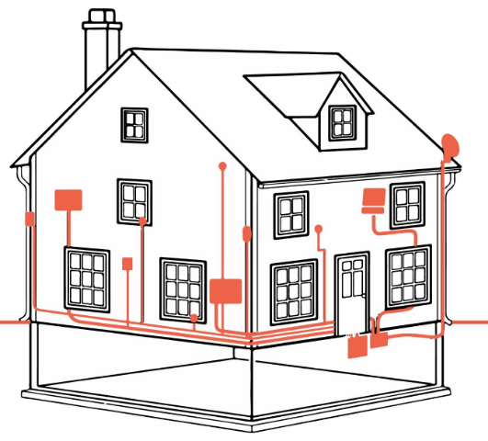
Conclusion
The issue of how to develop a conceptual model is discussed from two standpoints: first, by presenting a framework for conceptual modelling, enabling a modeller to design a conceptual model from scratch; secondly, by describing a number of methods for simplifying an existing conceptual model

Slide 7
References:
https://medium.com/zeyka/what-are-conceptual-models-daba6d7cc0bd
Simulation: The Practice of Model Development and Use by Stewart Robinson, John Wiley and Sons, Ltd, 2004

Slide 8
THANK YOU

